Slide 1

Undicesima Giornata Fiorentina dedicata ai pazienti con malattie mieloproliferative croniche
Sabato 17 Maggio 2025
Tiziano BARBUI
Ospedale Papa Giovanni XXIII
Fondazione per la Ricerca (FROM)
Bergamo

Slide 2
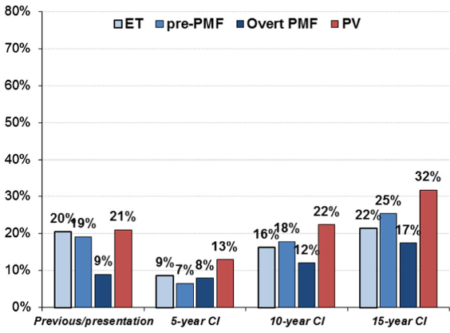
Frequenza cumulativa di nuove e precedent trombosi
in 1200 pazienti dopo 5, 10 e 15 anni
Barbui T, BCJ 2018

Slide 3
Profilo paziente Mario R:
Maschio, 58 anni, impiegato ufficio commerciale
Donatore di sangue per 20 anni
Storia clinica:
50 anni: infarto miocardico acuto → trattamento con stent coronarici, buon risultato.
  Fattori di rischio: fumatore (15-20 sigarette/giorno), Ipertensione arteriosa mal controllata, BMI alto (30).
  Emocromo normale al momento dell'infarto
  Buona tolleranza alla terapia antiaggregante
3 anni dopo infarto: Policitemia Vera
  Prurito post-doccia
  Emocromo: Hb 18 g/dL, HCT 55%, GB 12.000, PLT 400.000
  EPO bassa, JAK2 V617F (VAF 45%)
  Biopsia osteomidollare: panmielosi consistente con policitemia vera
  Milza non palpabile
Trattamento:
Salassi periodici, Oncocarbide (Idrossiurea), Aspirina, Sartani per l’ipertensione
Buona risposta clinica, ripresa lavorativa completa

Slide 4

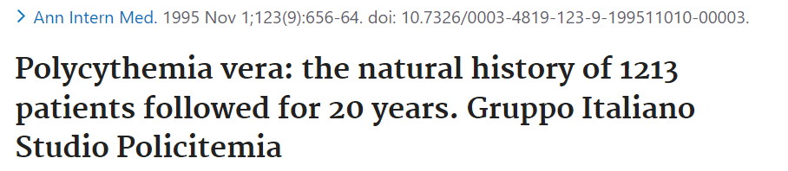
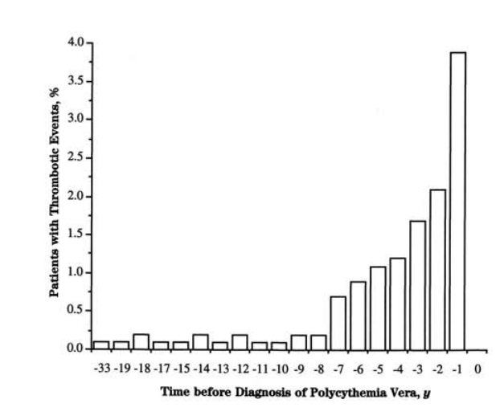
The incidence of thrombotic events increased during the 2 to 3 years before diagnosis. This finding strongly suggests a causal relation between the progressive expansion of the clonal disorder and the increased risk for thrombosis.
A latent form of polycythemia vera can be argued on the basis of the temporal relation between these events and diagnosis.
During the pre-diagnostic phase of PV, an excess of myocardial infarction and peripheral arterial events than after diagnosis was documented. Conversely, TIA/Strokes were prevalent at diagnosis (Higher HCT levels).
Writing Committee : T. Barbui and G. Finazzi; G. de Gaetano, R. Marchioli, and G. Tognoni; C. Patrono R. Landolfi

Slide 5
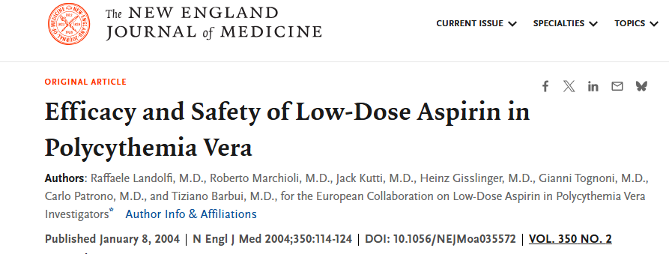

Slide 6
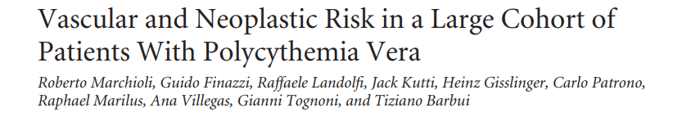
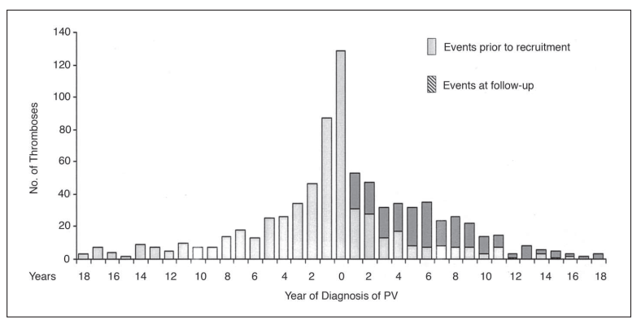
J Clin Oncol 23. © 2005 by American Society of Clinical Oncology
N= 1638

Slide 7
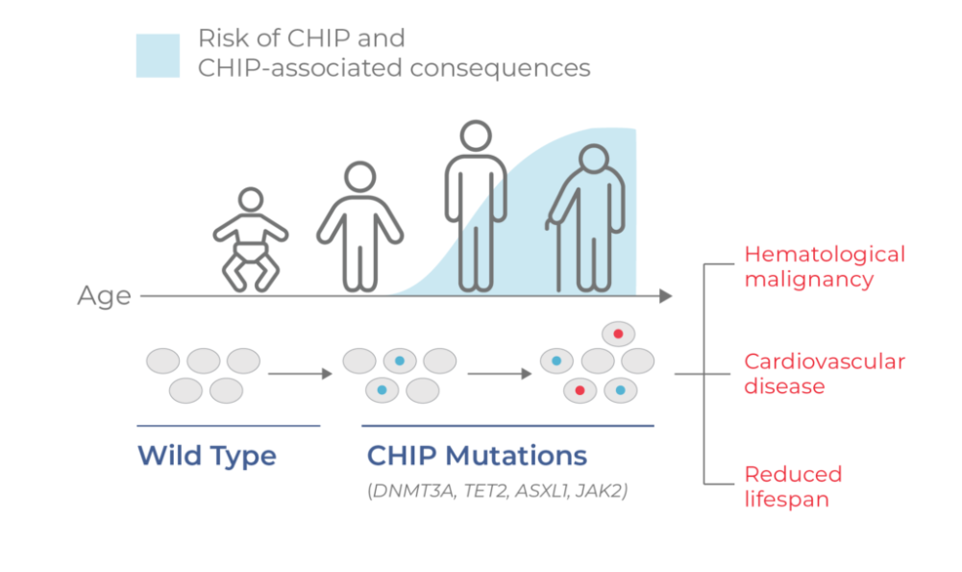
Clonal Hematopoiesis of Indeterminate Potential (CHIP) A pre-malignant condition that in many people does not present any clinical consequences.

Slide 8
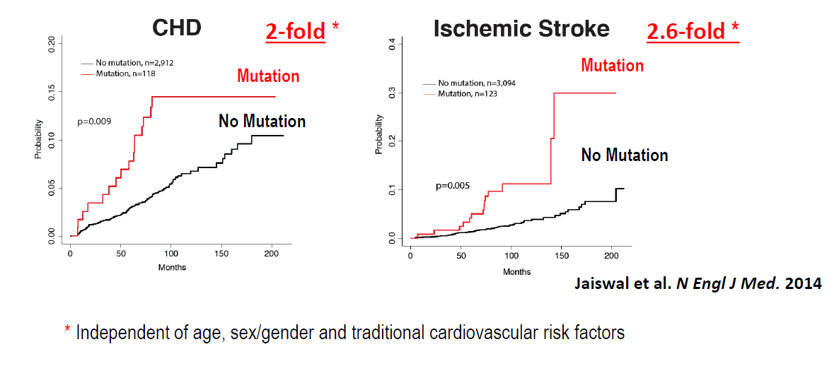
Somatic mutation-driven clonal hematopoiesis is associated with increased incidence of atherosclerotic cardio/cerebrovascular disease

Slide 9
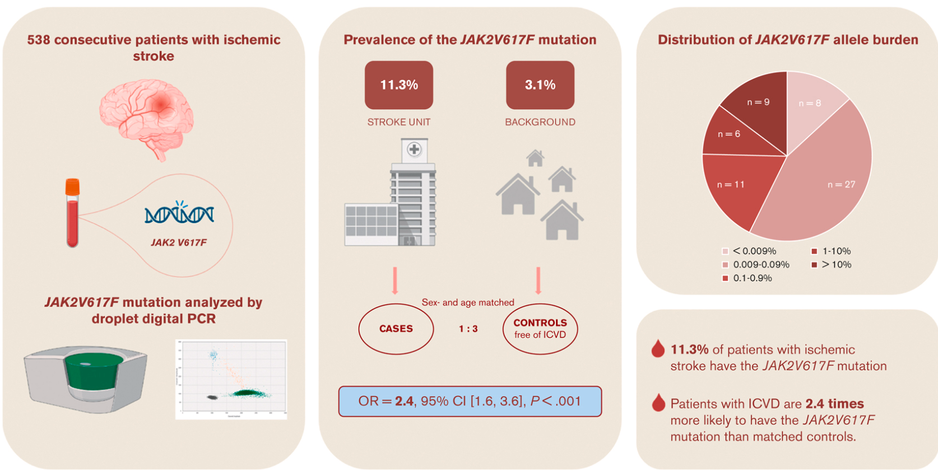
In 538 casi con Stroke l’associazione con la presenza della mutazione di JAK2 era più alta che nei casi di pari età senza stroke ma solo nei fumatori (P < .001)
Blood Adv, 2023

Slide 10
Fumare può favorire il rischio di MPN e trombosi
Pedersen KM et al., Cancer Med. 2018; 7:5796-5802
Methods
- Data from over 75,000 individuals in the Danish Diet, Cancer and Health cohort.
Participants were followed for the development of MPNs.
Smoking status assessed at baseline; hazard ratios (HRs) calculated using Cox regression.
Key Findings
- Smoking was significantly associated with increased risk of MPNs:
Current smokers vs. never smokers: HR 2.39 (95% CI: 1.64-3.48)
Dose-response relationship observed: Greater smoking intensity and duration associated with higher risk.
Conclusions
- Smoking is a modifiable risk factor for MPNs.
- Findings support including smoking cessation in MPN prevention strategies.

Slide 11
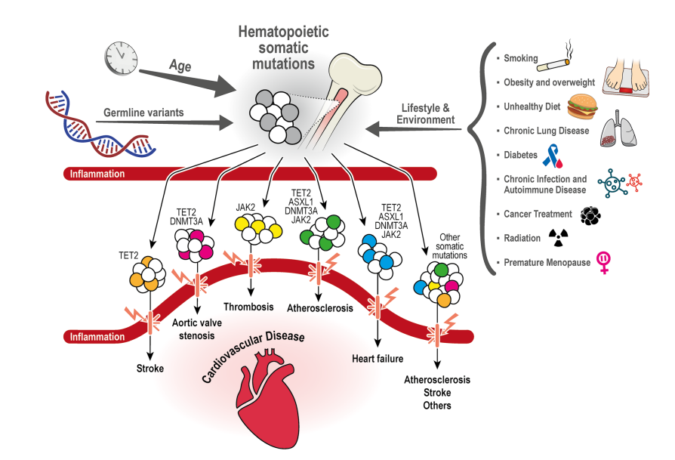
Fattori che possono aumentare il rischio di arteriosclerosis e trombosi Emopoiesi clonale , infiammazione e trombosi
Current Cardiology Report, 2022

Slide 12
N (%) IR %pts/yr HR p
750 (45) 1.30 1 (ref) -
638 (20) 2.15 1.66 <.0001
Barbui T et al, AJH 2017; Blood 2017

Slide 13
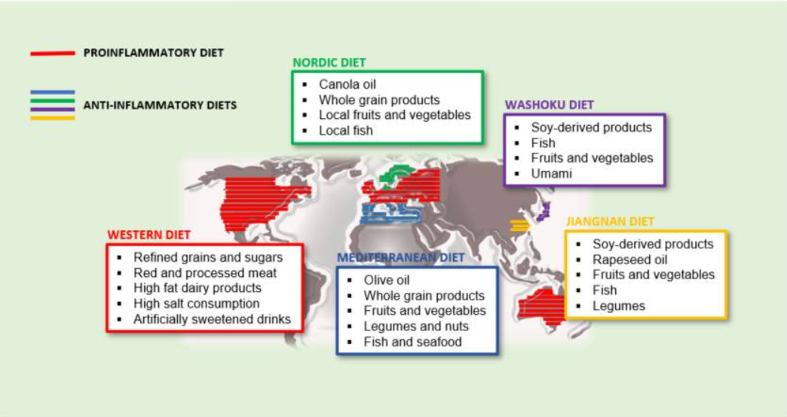
Proinflammatory and anti-inflammatory diets and its main distribution in the world.
Biomedicines. 2021 Aug; 9(8): 922.

Slide 14
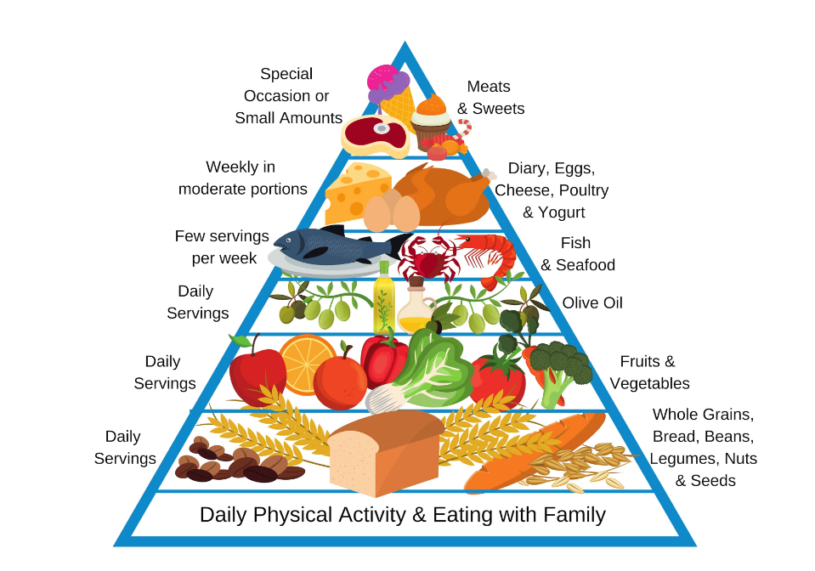
Dieta Mediterranea

Slide 15
Le frequenti donazioni di sangue possono aumentare il rischio di policitemia vera? Edgren et al., Transfusion 2016
Background
- Prior studies suggested possible increased PV risk among blood donors.
Repeated phlebotomy speculated to increase marrow activity and PV risk.
No studies previously assessed impact of donation frequency.
Study Design & Methods
Cohort Study: 1.4M Scandinavian donors (1980-2012); SIRs vs. general population.
Nested Case-Control: Donation history 3-22 years before diagnosis; ORs for donation frequency.
Key Results
PV Risk in Donors: SIR = 1.00 (95% CI: 0.89-1.13) ……………………. No excess risk.
Frequent vs. Infrequent Donors: OR = 1.01 (95% CI: 0.51-1.97) … No association.
Conclusions
- No evidence of increased PV risk in blood donors.
- No link between frequency of donation and PV risk.
- Frequent donations are not associated with PV

Slide 16
J Clin Oncol 23. © 2005 by American Society of Clinical Oncology
N= 1638

Slide 17
Frequenza cumulativa di nuove e precedent trombosi
in 1200 pazienti dopo 5, 10 e 15 anni
Barbui T, BCJ 2018

Slide 18
Incidence of thrombosis in contemporary
patients with PV (n=1,545)
Age < 60 years and no previous thrombosis
n=604 (40%)
Age ≥ 60 years and/or previous thrombosis
N=941 (60%)
International IWG-MRT
Annual Rate 2.08 %
    Stroke/TIA: 40 (32%)
    IMA: 13 (10%)
    PAT: 13 (10%)
    DVT/PE: 28 (22%)
    Splanchnic: 16 (13%)
    Other/Unk: 16 (13%)
    Annual Rate 3.14%
    Stroke/TIA: 64 (33%)
    IMA: 22 (11%)
    PAT: 21 (11%)
    DVT/PE: 60 (31%)
    Splanchnic: 11 (6%)
    Other/Unk: 17 (9%)
Barbui T et al, Blood. 2014 Nov 6;124(19):3021-3.

Slide 19
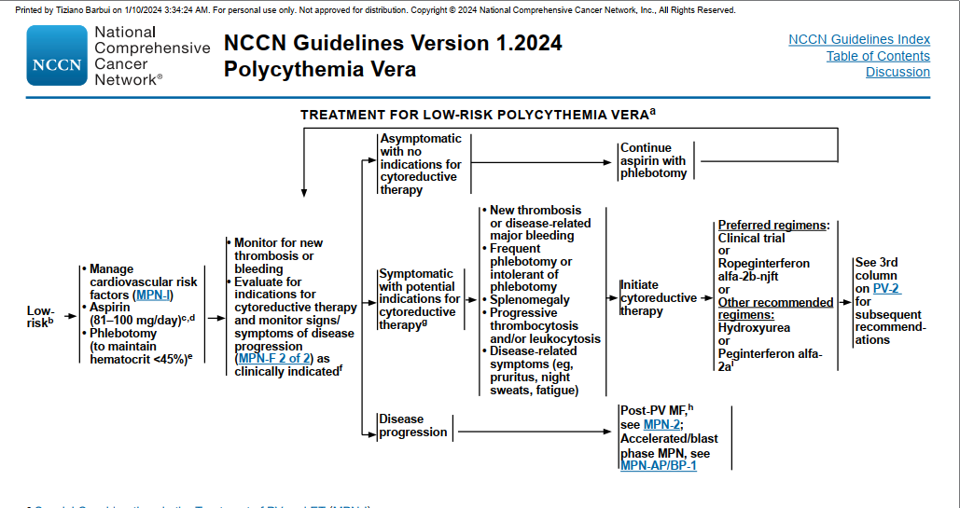

Slide 20
Come gestire la Trombocitemia oggi
Attenzione alla diagnosi
Il rischio di trombosi
Personalizza la terapia
La progressione
Il futuro della ricerca

Slide 21
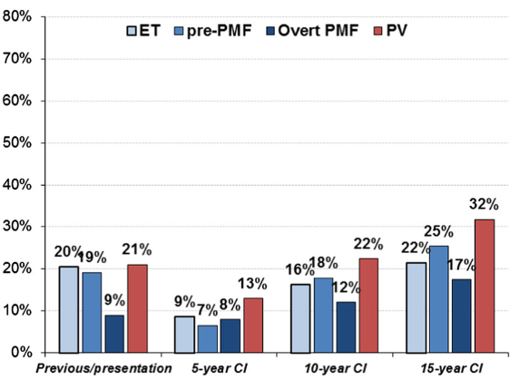
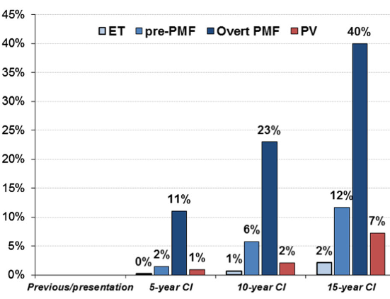
Mentre la trombocitemia e la pre-PMF hanno lo stesso rischio di trombosi
la probabilità di evolvere verso la mielofibrosi è più alta nellapre-PMF.
Trombosi
Mielofibrosi

Slide 22
Il rischio di trombosi
Very low thrombotic risk: No aspirin
No history of thrombosis
Age <60 years
Low thrombotic risk : Yes aspirin
No history of thrombosis
JAK2V617F-unmutated
No cardiovascular risk factors (CVR)
Age <60 years
High thrombotic risk: Aspirin twice?
History of thrombosis and/or Age ≥ 60 year
JAK2V617F-mutated and/or CVR present
JAK2V617F-mutated and/or CVR present

Slide 23
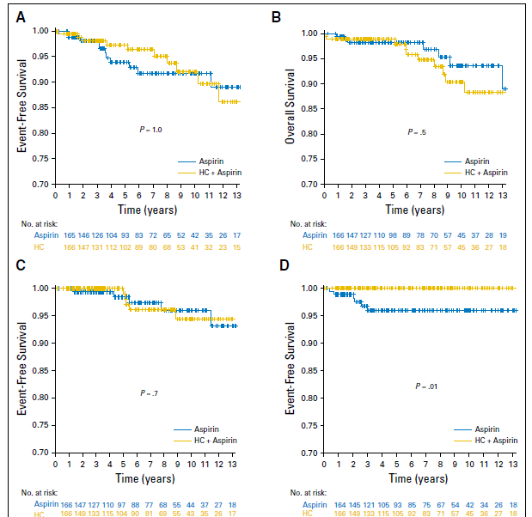
Trombocitemia Essenziale e piastrine 1.5 milioni: rischio di trombosi?
Hydroxycarbamide Plus Aspirin Versus Aspirin Alone inPatients With Essential Thrombocythemia Age 40 to 59 Years Without High-Risk Features
Thrombosis and death
Overall survival
CONCLUSION
In patients with ET age 40 to 59 years and lacking high-risk factors for thrombosis or extreme thrombocytosis, preemptive addition of hydroxycarbamide to aspirin did not reduce vascular events,myelofibrotic transformation, or leukemic transformation.
Patients age 40 to 59 years without other clinical indications for treatment (such as previous thrombosis or hemorrhage) who have a plateletcount,1,500x 10L should not receive cytoreductive therapy.
Transformation to MF,AML,MDSl
Transformation to PV

Slide 24
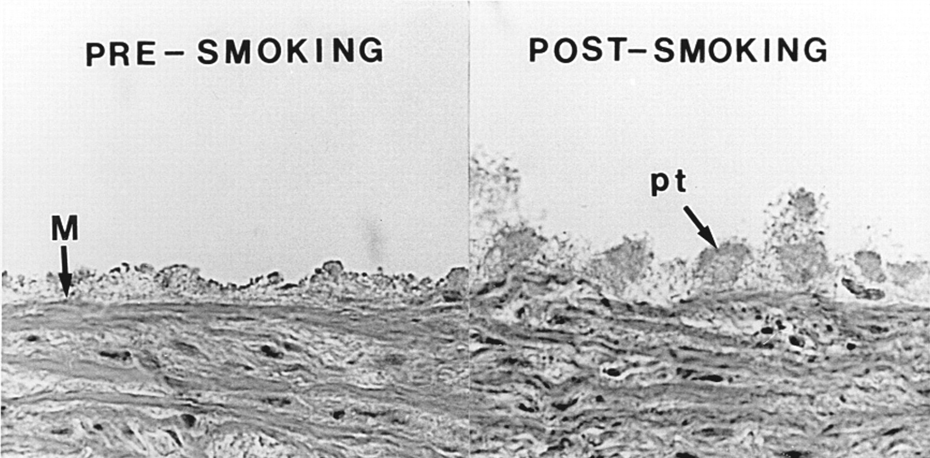

Representative histological section of a middle section of the porcine media showing the acute increase in platelet thrombus (pt) formation at a shear rate of 2546 s−1, after smoking compared with pre-smoking control.
Joseph Hung et al. Circulation. 1995;92:2432-2436
Copyright © American Heart Association, Inc. All rights reserved.
Notes:
Representative histological section of a middle section of the porcine media showing the acute increase in platelet thrombus (pt) formation at a shear rate of 2546 s⁻¹, after smoking compared with presmoking control. M indicates arterial media and elastic lamina.

Slide 25
Cosa ci aspettiamo nei prossimi anni: Interrompere il decorso della malattia oltre alla trombosi
Symptoms (Independent of Risk)
Cytokine: fatigue, pruritus, constitutional symptoms, bone pain
Vascular: headache, dizziness, numbness, decreased concentration, low mood, sexual issues . Disease evolution: splenomegaly, constitutional symptoms
Thrombosis
Micro/macrovascular
arterial > venous
Unusual sites:
younger women
Disease transformation
MF
AML
Newly diagnosed
Typically second decade
Mesa RA, et al. Cancer. 2007;109:68-76. Scherber R, et al. Blood. 2011;118:401-408. Geyer HL, et al. Blood. 2014;124:3529-3537. Stein BL, et al. Ann Hematol. 2014;93:1965-1976. Stein BL, et al. Leuk Lymphoma. 2013;54:1989-1995 Barbui et al, leukemia 2018.

